Slide 1



The Global Aid
Match System
Team GAS · China · BOC

Slide 2



CONTENTS
Proposal Introduction
Solution Background
The Global Aid
Match System
Solution Introduction
Technology Frame
Solution Value
Solution vision

Slide 3
1
The Global Aid
Match System
Proposal Introduction
A brief introduction of our solution

Slide 4
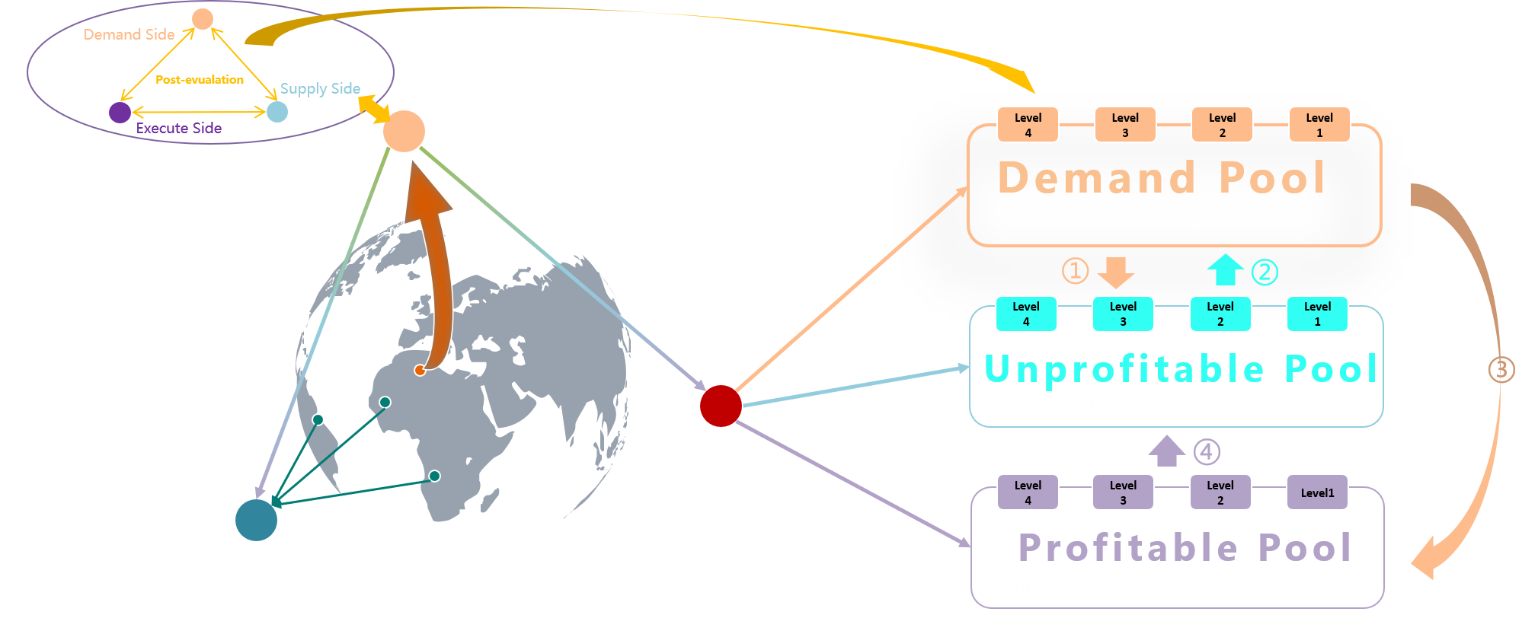
Proposal Introduction
“
Global Aid System (GAS）is a system based on the IBM Hyperledger technology. It uses an excellent matching algorithm to match the reserved resources with the sudden demand, forming a working contract of participants and providing information communication and post-evaluation measurement for the establishment of disaster aid chain.
“

Slide 5
2
The Global Aid
Match System
Solution Background
This section mainly introduces solution background and pain points

Slide 6
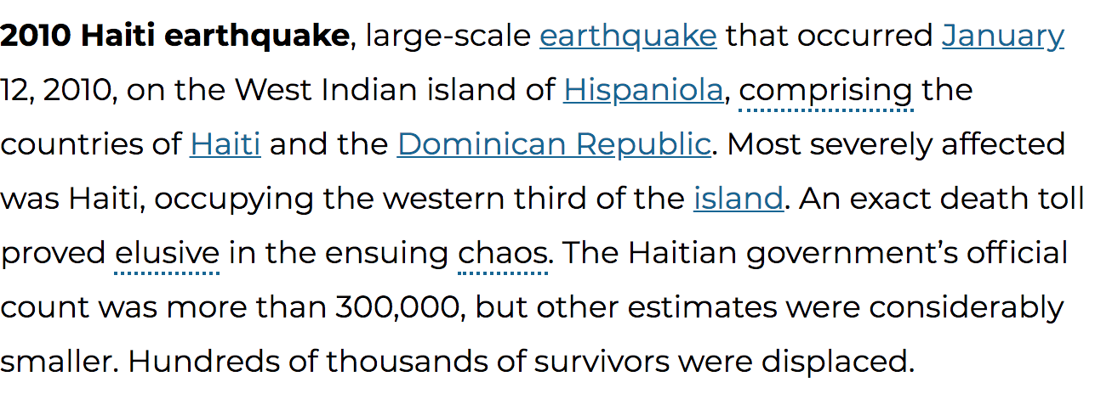
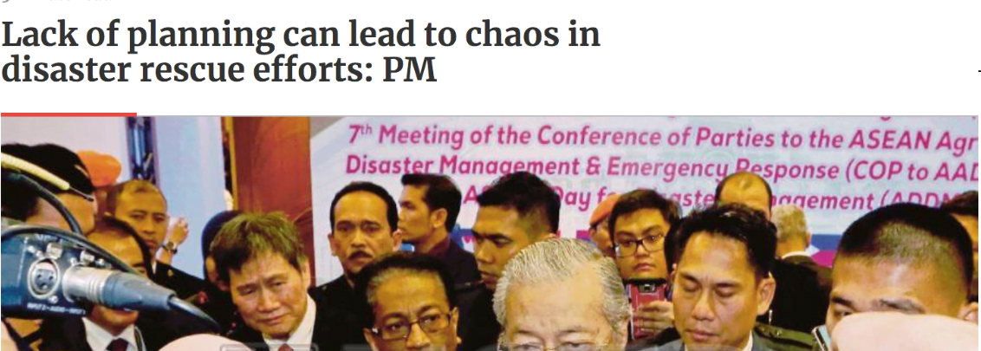
Solution Background
In the process of rescue, the civilian rescue forces often have pain points such as chaos, disorder, and uneven resource allocation. They may even bring hindrance.
During the Lushan earthquake, a large number of private vehicles rushed to rescue, leading to the blockage of the rescue channel. In response to this issue, on April 21, 2013, the Central State Council issued a notice, requesting that all regions, relevant departments, units and social organizations to not arrange groups and staff to go to the disaster area in the future.
How to form an effective civil disaster aid chain and joint force with the main rescue forces quickly?

Slide 7

Solution Background
① Lack of system-level disaster relief solutions
The current rescue process is based on offline communication from all participants. Chaotic and inefficient, it is lack of system-level rescue solutions,
② Lack of global vision forms an information island
At present, the rescue information release and acquisition is mainly disseminated through media through participants and neutral organizations.
③ Lack of mutual trust mechanism makes it difficult to make an agreement
Disasters often occur suddenly, and the demand side and the supply side often do not know each other. It is difficult to quickly reach a consensus under the lack of mutual trust mechanism and thus difficult to achieve rescue.

Slide 8
Solution Background
④ The lack of schemes results in uneven resources allocation
For many types of disasters and resource correspondences, there is a lack of a global resource scheduling scheme. The problem of uneven resource allocation and low allocation efficiency is caused by offline scheduling.
⑤ Lack of evaluation mechanism makes it difficult to give constraint feedback
After rescue is complete, most of the evaluations rely merely on the media. The lack of evaluation mechanism makes it hard to constrain the behaviors and effects of execute party in the rescue process.
⑥ The Lack of information traceability helps corruption
The tracking information of materials is mainly concentrated offline under the current mechanism.
The information is difficult to be transparent and visible to all parties, and thus it can easily breed corruption.

Slide 9
3
The Global Aid
Match System
Solution Introduction
This section mainly introduces the solution’s scheme

Slide 10
Business model
Demand Side
Post-evualation
Supply Side
User Node
Execute Side
Level 4
Level 3
Level 2
Level 1
Tripartite Workspace
Demand Pool
Pool which collects people’s demand
①
②
Level 4
Level 3
Level 2
Level 1
Unprofitable Pool
③
Pool in which resources are free
GAS Node
④
Level 4
Level 3
Level 2
Level1
Profitable Pool
User Node
Pool in which resources need to be bought with money

Slide 11
Service Roadmap
Main Service Roadmap
Through information chaining, and disaster information release, the GAS system can effectively match the demand side with the supply side and execute side to form a complete rescue chain.
01. Information chaining
A user is formed through free registration and verification. After a user is formed, users can publish relevant material information and allow rescue to be initiated. The information will be synchronized to the GAS node by the block-chain mechanism.
02. Disaster condition release
When a disaster occurs, users can log in to the GAS system to release relevant disaster demand requirements, and the disaster situation will be synchronized to the GAS node by the block-chain mechanism.
03. Matching process
GAS System will form demand pool, unprofitable pool and profitable pool according to the demand side and the materials of supply side and execute side. The matching algorithm will match the need of the demand side with the supply side. After the matching process is completed, a working contract is formed.
04. Working evaluation
The tripartite contract information will be published on the chain, establish a tripartite workspace and allow the working process information to be released. The information is open and transparent to all participants, and the rescue work is carried out in an orderly manner. After the work is completed, each party will be evaluated, and the relevant evaluation elements will affect the matching priority.

Slide 12
Algorithm introduction
Algorithm summary
The main algorithm outlines the matching algorithm through the priority design to ensure that the service scope and resource characteristics are ensured.
01. Match service scope and differentiate participation level
First, by matching the longitude and latitude information (x, y) of registered users with all the suppliers and executors in their service areas (x + 1000, y + 1000), four levels of unprofitable pool and profitable pool are formed according to the score of the chain of service providers
02. Top-down search，unprofitable pool first
priority are given to retrieving resources in the form of 4-3-2-1 . Only when the resources in the upper pool are insufficient, resources are requested from the lower pool. Matching should be carried out in the from unprofitable pool and then profitable pool and finally return to the unprofitable pool to gain funds.
Demander
03. Calculating Service Distance to Ensure Service Efficiency
In the same level of resource pool, we will first calculate the distance between the affected party with the supplier. We believe that it is more important to rescue lives quickly.
04. Referring to Resource Attributes, Making Resource Performance-price Ratio
When resources are insufficient, the order in which resources are satisfied is defined by the priority of the resources. The resources that guarantee life (such as bread) are prior than the resources that resettle (such as tents). In addition, when the indicators are the same, the cost-performance ratio of resources will be taken into account, and the resource with high cost-performance ratio will be considered first.

Slide 13
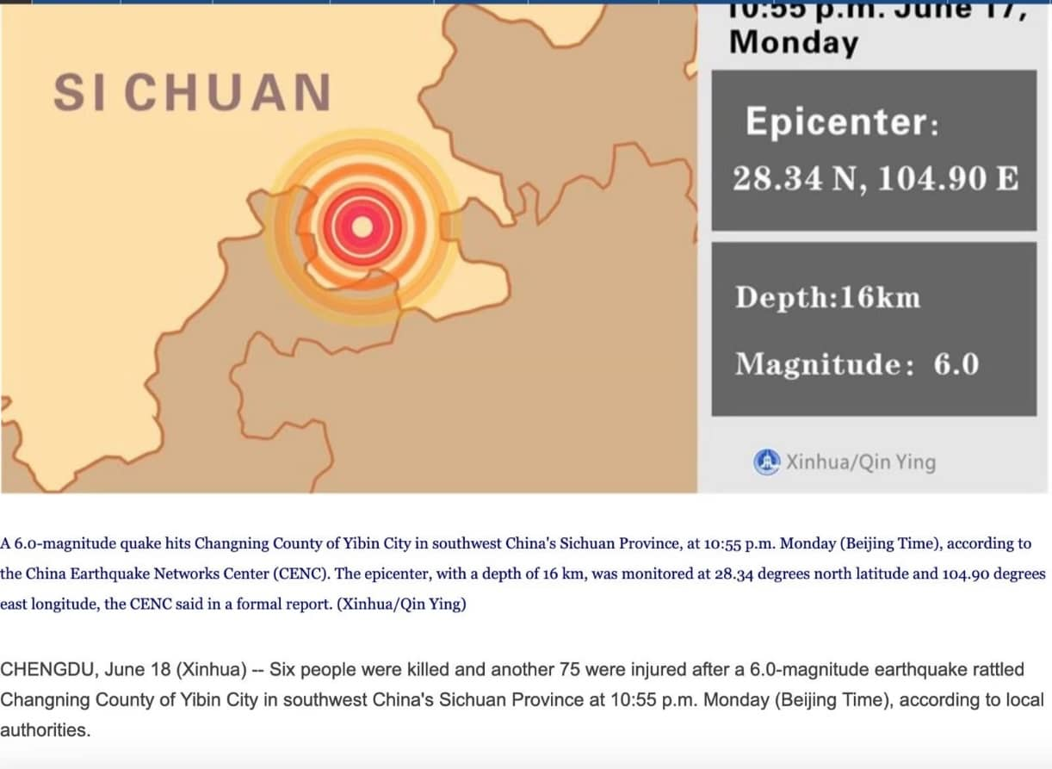
User story
At 2:55 on June 17, 2019, a magnitude 6.0 earthquake occurred in Changning County, Yibin City, Sichuan Province, China.
As of the second day, the incident caused
11 Deaths
122 Injured
14 Trapped
922 Household Collapsed
What are the differences between traditional rescue and GAS system rescue?？

Slide 14
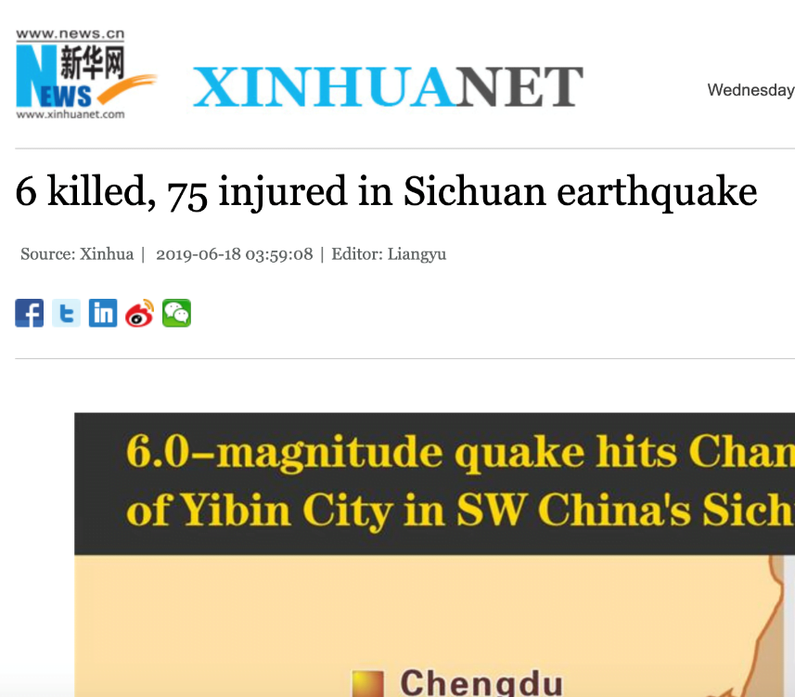
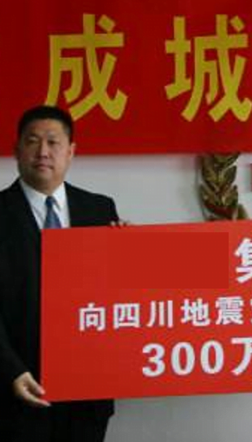

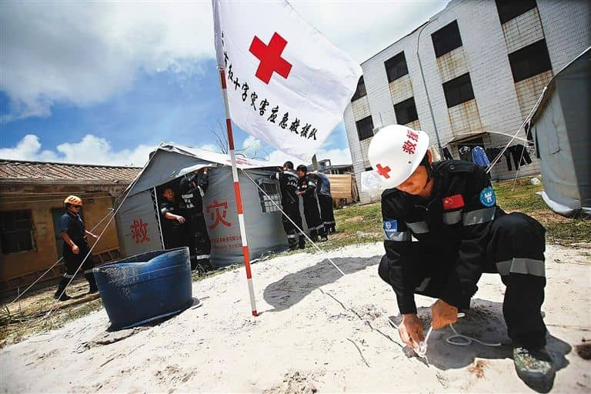

Traditional rescue-Step1
Some institutions cannot determine the authenticity of information
Organizations with rescue forces are unable to provide assistance because of poor information and lack of assistance needs information.
Some organizations make donations. But they can not determine the authenticity of the information
Relevant information about earthquake is reported through traditional media
Civil forces decided to provide assistance after learning about disaster

Slide 15
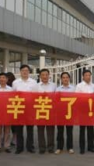
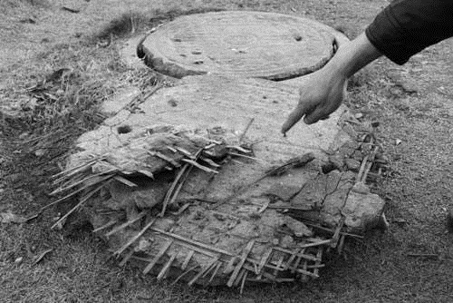
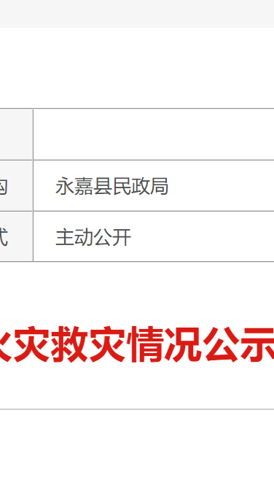
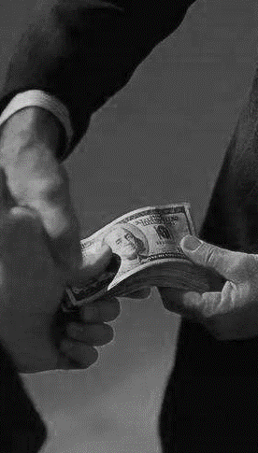

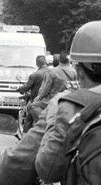
Traditional rescue-Step2
Lack of post-evaluation constraint mechanism, it is difficult to constrain the implementation effect
Information opacity can breed corruption easily
Congestions and lack of resources occurs due to uneven scheduling
All rescue parties return back after the rescue is over
Some donor agencies and the recipients announced the rescue information after the disaster
Civilian forces spontaneously go to the disaster area

Slide 16
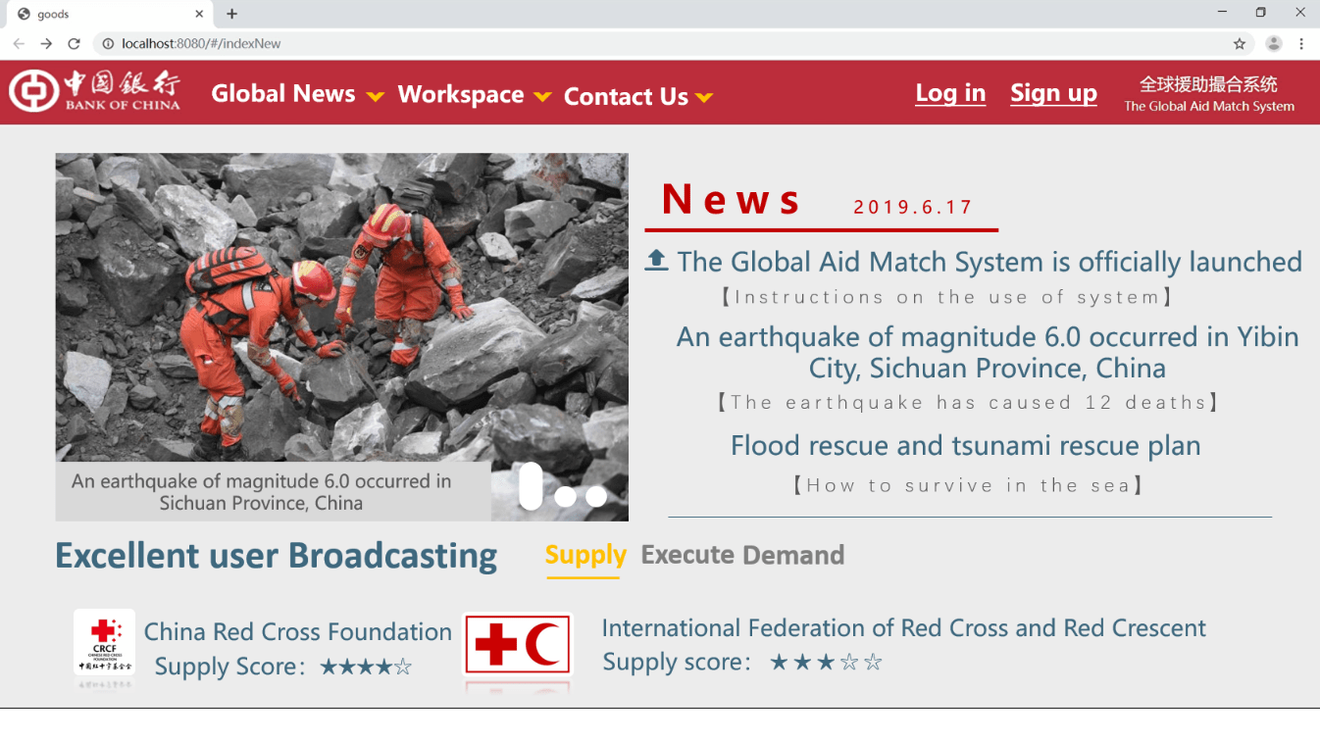
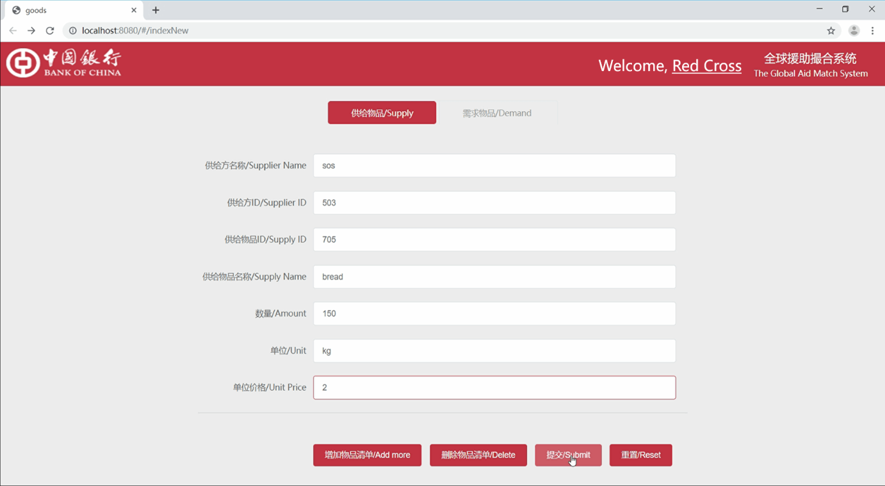
GAS Mode-Initiate rescue
Serve the world, Aid the world
The staff of Yibin City use the registration information to log in to the GAS system, select the identity of the demander, and issue the assistance request.

Slide 17
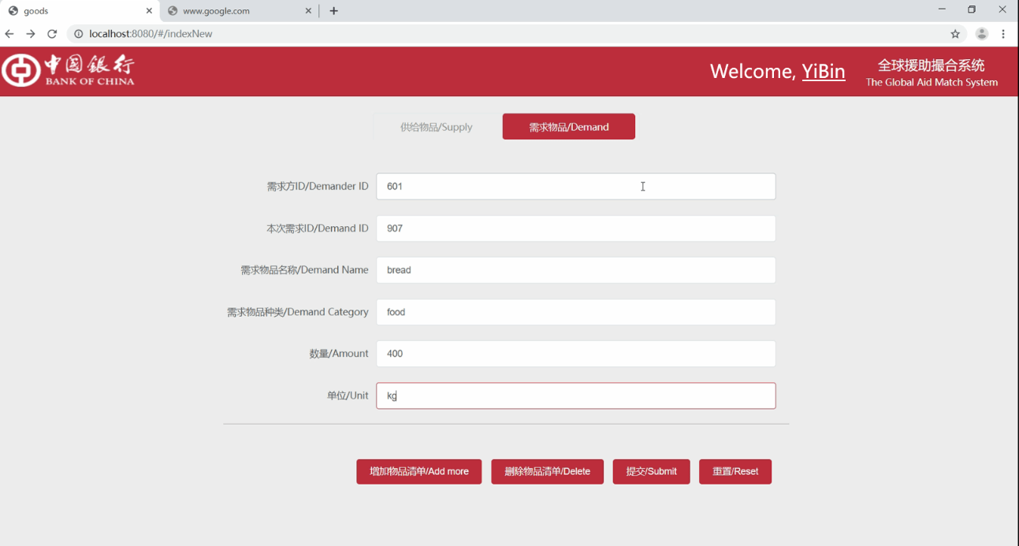
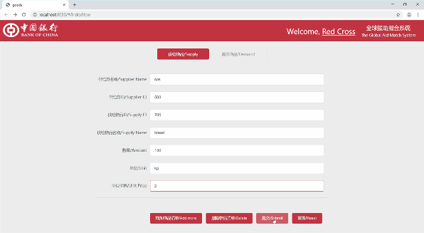
GAS Mode-form resource pool
After the request is completed, the GAS system will provide the information of demand side and execute side within the within the geographic service scope and form a Form a tripartite contract.
Demand Pool
Information is released by the demand side in real time
Profitable Pool
Execute Side release the information previously
Unprofitable Pool
Information released by the supply side previously

Slide 18
GAS Mode-Match Arithmetic
Demand Pool
Profitable Pool
Unprofitable Pool
①
④
Match with Service Range
Match with profitable Pool
Geographical match (28.43,104.90)∈(88.71±1000,186.11±1000) √
200<300 Get 200 Cost 200*2=400 √
⑤
②
Match with Fund
Match with unprofitable Pool
400<100000 √
400>200(-200) Get 200 Cost 0 √
⑥
Create Work Space
③
Match with Service Range
601 YiBin Bread 400kg
503 SOS Bread 200kg 400Yuan
Geographical match (28.43,104.90)∈(60.21±2000,300.11±2000) √
501 Rea Cross bread 200kg
501 Rea Cross Fund 400

Slide 19
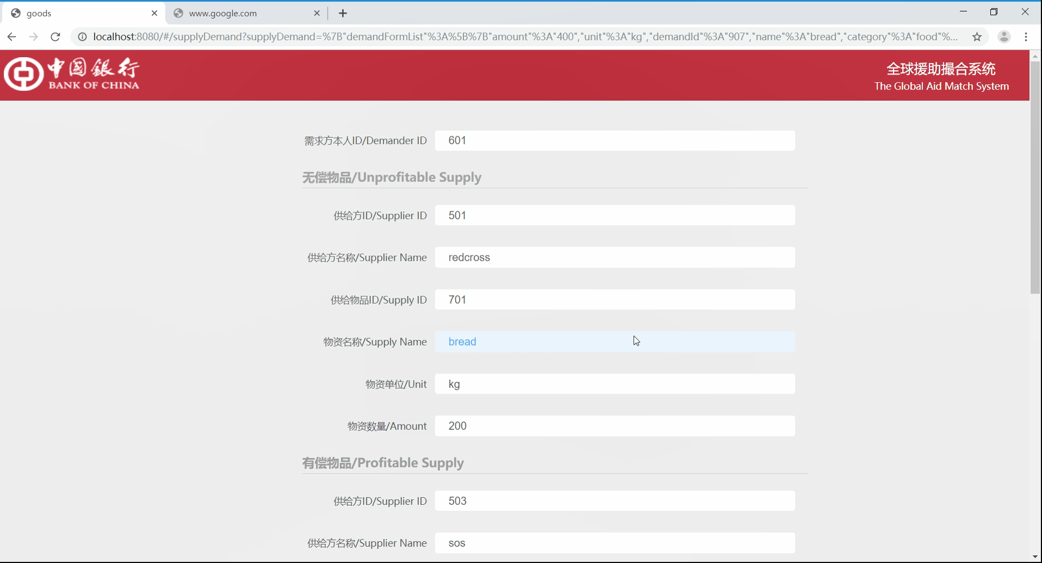
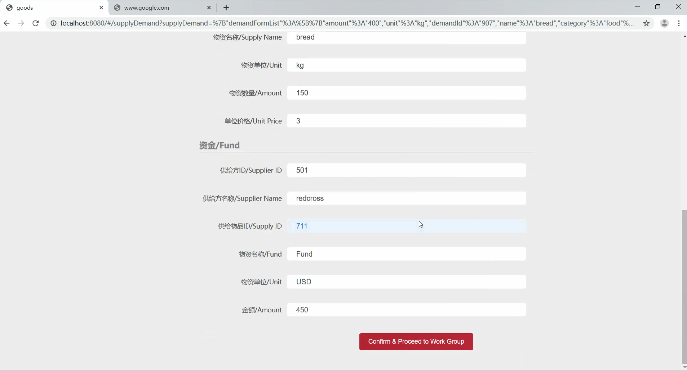
GAS Mode-Match Results
Matching Results
Through our matching algorithm, the required resources are allocated and results are displayed. The participants will confirm the results and enter the workspace to implement actual rescue.

Slide 20
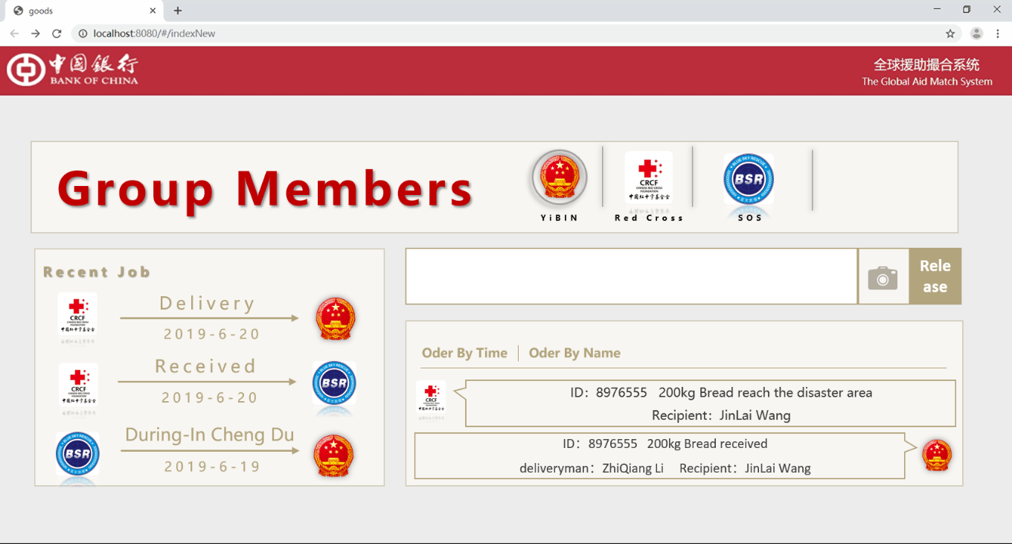
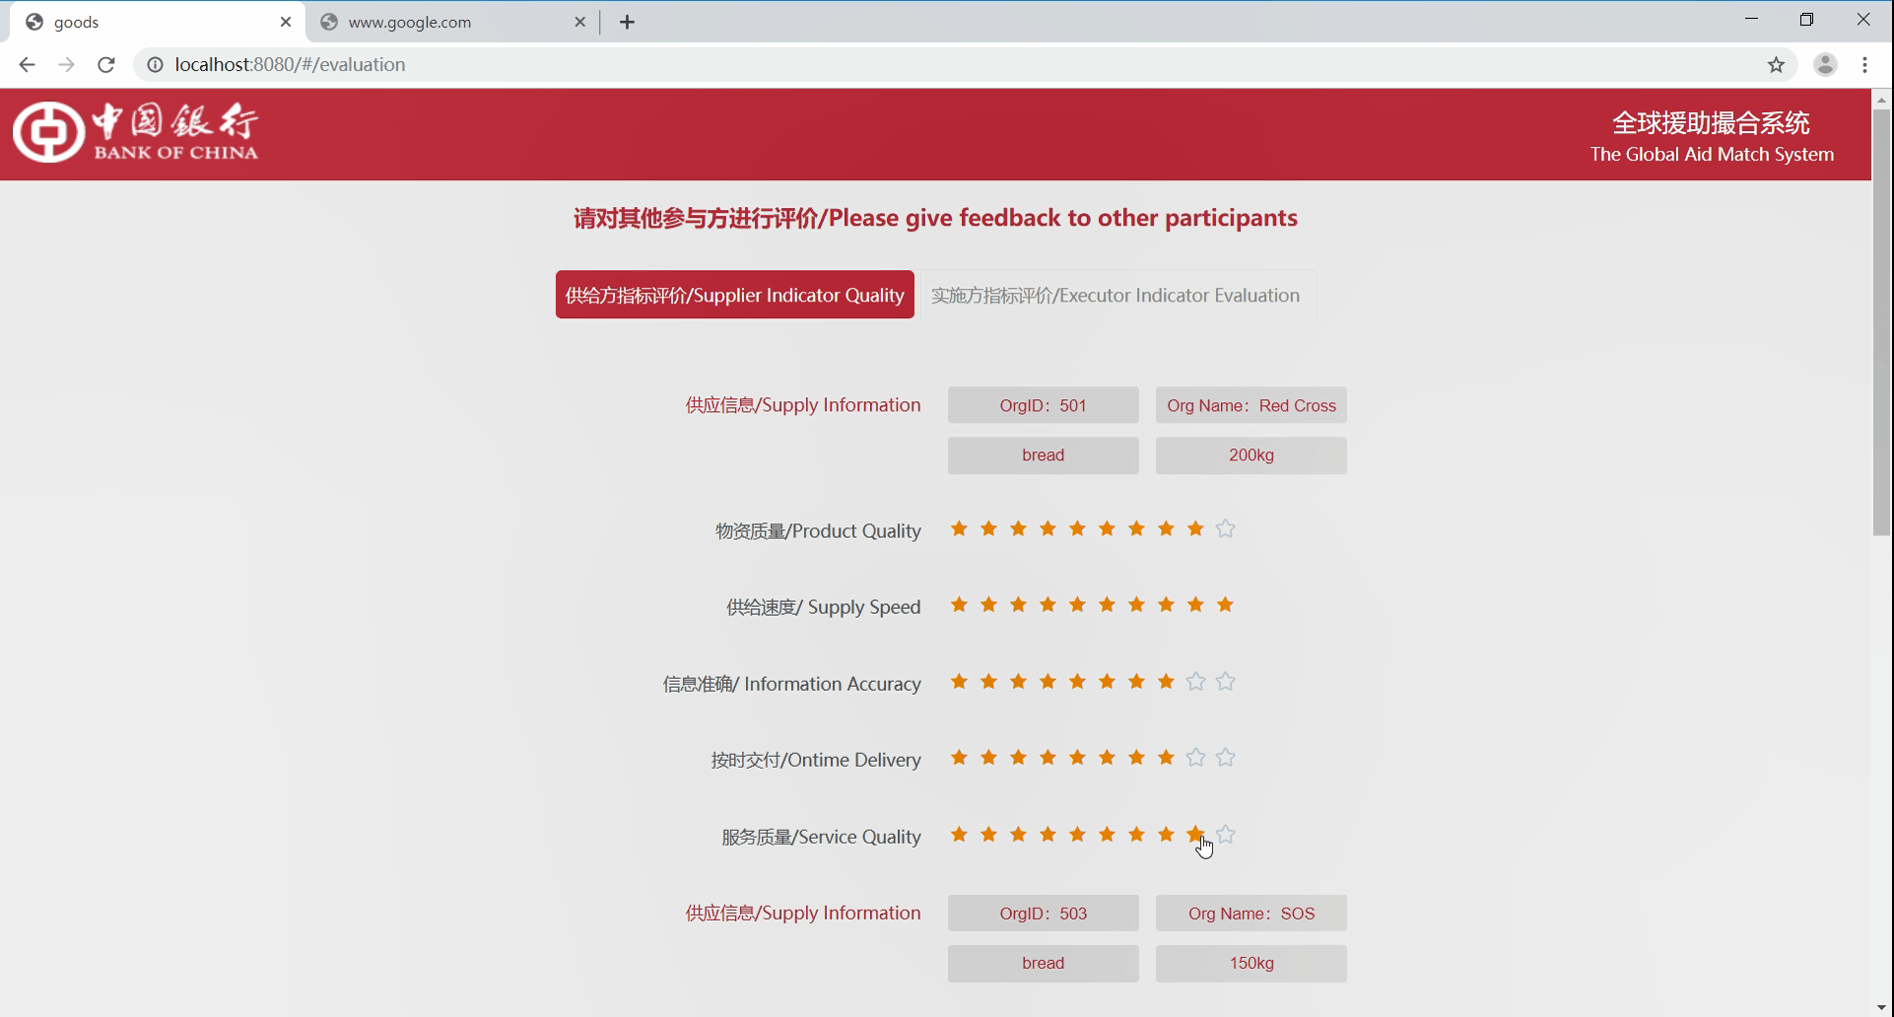
GAS Mode-WorkSpace&Evaluation
Evaluation offline
After the formation of the tripartite contract, a working space is formed to facilitate rescue interaction. When the post-evaluation after rescue is completed, the evaluation indicators will affect the matching solution.

Slide 21
4
The Global Aid
Match System
Technology Frame
This section mainly introduces the technical architecture

Slide 22
Technology Frame
Front Page
IBM
Smart Contract
IBM Blockchain Platform
GAS Server
（Based on IBM Cloud Service）
Log in（WEB/APP/H5）
Publish material information
Information uplink and broadcast
Information publish
Log in（WEB/APP/H5）
Publish the demand information
Information uplink and broadcast
GAS system gets demand request
Query material information on chain
Match the needs
Form priority relationship according to evaluation
Match service scope
(IBM Iot GPS)
Match unprofitable resources（in the order of distance and urgency)
Match the profitable resources, calculate fees
Forms a workspace
Information uplink and broadcast
meet the requirements and form a contract after matching.
According to the fees, return to unprofitable pool to match funds
Publish work situation
Push Working Information
Information uplink and broadcast
Machine Learning
Data Mining
AI
Go over work situation
Push Working Information
Pull the working information of participants
Work tracking
Release evaluation score (including display)
Calculate the evaluation score according to the rules
Additional Scores uplink and broadcast
Complete evaluation

Slide 23
5
The Global Aid
Match System
Solution Value
This section mainly introduces the value of this creation

Slide 24












Service Scope
GAS System can serve
China
Japan
Republic of Indonesia
Cayman Islands
Rockefeller
Blue leopard rescue
Blue sky rescue
…
Pfizer Group
Sinopec Group
International volunteer
The Global Fund
UNICEF
(United Nations International Children's Emergency Fund)
Government, region, consortium, foundation, volunteer organizations, companies, etc...

Slide 25
Business Advantage
Create a global perspective
This Solution has created a global-oriented resource matching system and achieved the global information exchange and matching. It solved the information island situation to a great extent.
Resolve the mutual trust issue
The solution is based on the blockchain, and the information is transparent and efficient. During disaster, the mutual trust problem of the participants is effectively solved, The information can be traced throughout the process to prevent corruption.
Allocate resource effectively
The resource allocation in the resource pool is realized through the matching algorithm to ensure that resource allocation is reasonable. The demand request is fulfilled. The waste of resources and the opacity of information are avoided.
Create a rescue force
The rescue chain is formed through resource matching. Whoever pays and whoever works for the benefit is clear at a glance, The overall rescue process is efficient and ordered, and it is combined with the official rescue force.

Slide 26
Technology Advantage
Uses mature technology
Using mature technologies such as block-chain and open source code construction, our technology is mature and stable. The deployment of our technology is simple, and it can be easily implemented.
Can be easily developed and operated
The whole solution is based on the development of IBM system related service components. It facilitates the subsequent function expansion and facilitates the overall service operation and maintenance.
Excellent Matching algorism
On the one hand, the matching scheduling algorithm refers to the overall evaluation of the participants in the system. On the other hand, it combines the relevant priorities of the supplier and the demander, making the matching more precise. At the same time, the matching algorithm can be combined with machine learning and other technologies to further improve the intelligence of our algorthism
Easy to implement
The code is open-sourced and packaged, making it easy for other products to be migrated and implemented. It can be effectively customized and applied to other matching scenarios.

Slide 27
6
The Global Aid
Match System
Solution vision
This section is mainly about product design

Slide 28
More to do…
Three working mechanism
Enrich the matching algorithm
Based on the three-stage characteristics such as disaster-based rescue, post-disaster reconstruction, and returning to normal ,we will release three working methods to ensure the efficiency, quality and effect. Dispatch mechanism is shown in the DEMO.
Using big data mining and machine learning, we will further enrich the matching algorithm to achieve the more accurate matching of supply and demand. We will also provide forecasting and model calculation for material reservations.
Online and offline collaboration
Establish role control
Increasing the matching of logistic participants and financial participants, we will use the tripartite contract to as the cornerstone to dispatch the logistics and financial services. At the same time, information is released with both software and hardware to ensure the order of allocation and ensure the consistency between online and offline.
We will establish a role control system to distinguish the roles of each node in the system, We will also open the access verification and responsible mechanism to reduce the standard for joining the system and thus, increase the number of participants.
Improve accessing mechanism
Establish evaluation criteria
Through secure deposit and Incentive mechanisms，（such as the post-evaluation system), the authenticity of information and the fulfillment of contract are ensured, At the same time, after establishing a complete access mechanism, we will consider adding personal help-seeking services as personal nodes to participate in the matching.
Through the decentralized evaluation system, we accurately evaluate every party in the rescue process. We will strive to form the industry standard through the evaluation indicators by the long-term operation, thus forming a beneficial circle of access, service and evaluation.

Slide 29
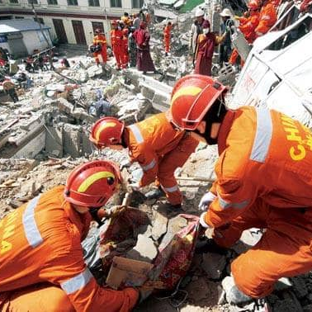
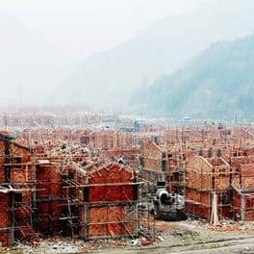
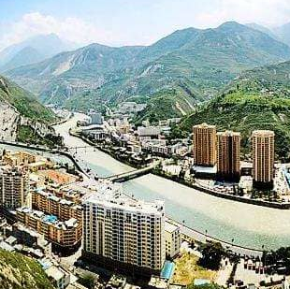
Three working mechanism
In the rescue phase, the main concern is to establish a rescue system quickly to save people‘s lives and properties. Therefore, in this case, we will use the match ordering mechanism directly and no longer wait for the three parties’ consent. We will give the order to the reserved three- parties to ensure the efficiency.
In the reconstruction phase, our main concern is to make buildings, public facilities and networks in the affected areas to return to normal in the shortest time. Therefore, the bidding by the demand side will be used. The supply side will fund the capital, and the executor will bid to ensure the quality of the reconstruction.。
In this phase, our focus is on how to restore living quality before disaster in the affected area, including job placement, social order establishment, and psychological counseling. Therefore, the mechanism of oriented information publication and oriented matching is adopted.
Bidding
Oriented
Giving order
Rescue Phase
Reconstruction
Back to normal

Slide 30
Offline and Online coordination
After the tripartite matching, a rescue contract plan will be formed based on materials, personnel and funds . According to the plan, it will be broadcasted to the second chain to
match logistics and finance in the matching system
Logistics
Finance
Logistics is the main artery in the process of rescue. Only when the main ”artery” is unimpeded can materials and personnel be delivered to disaster sites with high efficiency.
Financial services are “blood cells” in the process of rescue. Only when the capital chain is guaranteed can the material supply chain be uncracked,.

Slide 31
Improve accessing mechanism
“
By introducing the penalty and award mechanism, the block-chain will automatically produce some “rescue coin”.
The initial nodes use real money margin to purchase certain bounty as the initial fund. Subsequently, with the development of the business and the completion of the contract, the system will automatically generate a certain amount of bounty to issue or deduct the incentives of non-performing nodes.
At the same time, the GAS system can be transplanted to meet the registration application of individual nodes and its related needs, and the GAS system will match individual needs after customization.
“

Slide 32
Enrich the matching algorithm
01
Machine Learning
Machine Learning is used to enrich the matching algorithm and make the matching algorithm more intelligent to understand the needs and preferences in the process of rescue and provide a more intelligent matching scheme.
MATCHING
ALGORITHM
02
Machine Learning
Using big data mining to enrich matching algorithm, the algorithm can build an accurate disaster relief model to provide a quick and accurate matching experience for victims in the event of disaster.

Slide 33
Establish role control
Regular Node
Parent Node
The regular node is registered on the chain at the organizational level. It has the authority to participate in information releasing and demand proposing.
The parent node is the superior than addition to the information publishing and requirement publishing, it can also publish information for the child node and manage the child node.
Child Node
Proxy node
Proxy node is the set of users. Small organization users can access the chain through proxy node. Proxy node will verify its authenticity and publishes its needs and information. The information of all small users is aggregated into proxy node’s information.
As a regular node，it can publish registered user’s information and demand. It can also receive the management of parent node. The resource changes of the child node will affect the parent node.

Slide 34
Establish evaluation criteria
“
Through the long-term decentralization of the post-evaluation system deployed on the intelligent contract, all participants can get a real and effective score.
Such score will make the evaluation system of GAS system to become the evaluation standard in the actual rescue process.
“

Slide 35
THANKS!

